Slide 1
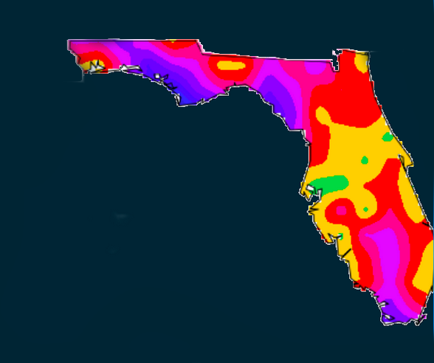
Team FloriDUH
Health Datapalooza Code-A-Palooza
June 2, 2014 Washington, DC

Slide 2
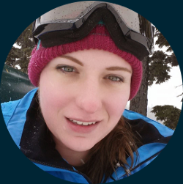

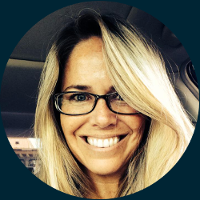
The Team
Lauren Still
San Francisco
Platform Dev
Nick Kypreos
Seattle
Data Science
Mandi Bishop
Jacksonville
Healthcare

Slide 3
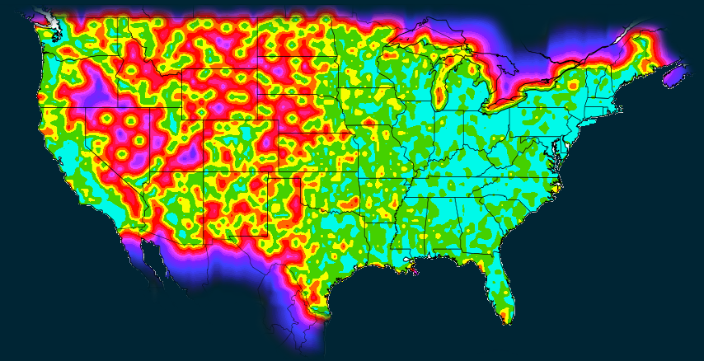

The Void
Measuring healthcare deserts to achieve triple aim goals: Better Health & Better Care at Lower Costs
Miles to Care
0 70 150 250

Slide 4






Patient Care Problem
Case Study: Joe & Meryl Retiring in Florida
Joe: High BP, High Cholesterol, Enlarged Prostate
2 Comorbidities
Multiple Chronic Conditions
MCC patients account for 93% of Medicare spending
Meryl: Diabetes, Kidney Disease, Depression, Needs Home Health
3 Comorbidities
Inpatient care is 24% more expensive for MCC patients
Florida: Retirees need help evaluating communities
66% of Medicare patients have multiple chronic conditions
Notes:
Merg slides 8 and 5…. Two stories… revisit slide 4, build out a bit more with other data, delete slide 6? Or slide 6 scrp underdog
Need healthcare navigation for the entire family:
Where is The Void for Joe?
Where is The Void for Meryl?
Where can The Underdogs safely and comfortably live?
Richie needs healthcare navigation for his hospital system.
Where is The Void for attributed ACO members?
Where is The Void for frequently-occurring MCC comorbidities?
Where could The Void be influencing HCAHPS detractor scores?

Slide 5
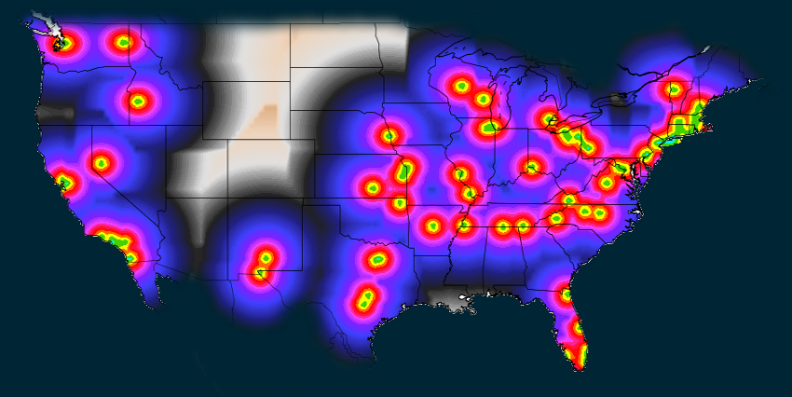
Patient Solution
Joe & Meryl upload their CCDA and find joint care hotspots
Miles to Care
0 70 150 250

Slide 6
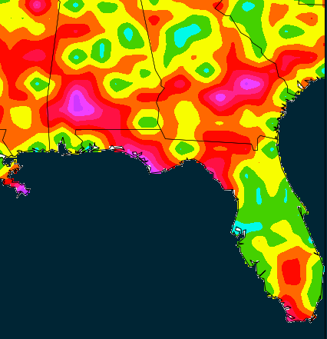
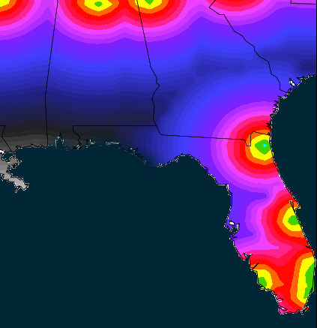

Individualized Mapping
Joe: 2 Comorbidities
Joe & Meryl Together
Miles From Provider
0 70 150 210

Slide 7


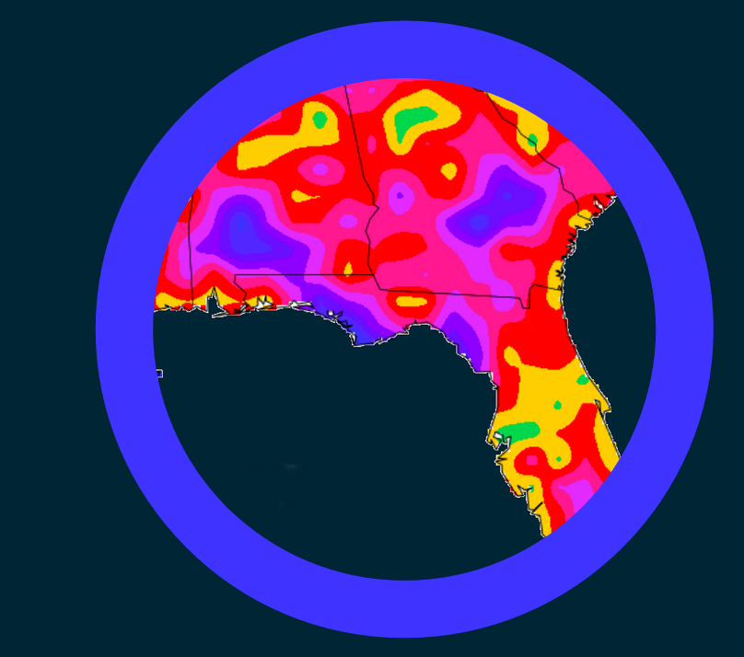
How It Works: UI
1
2
3
Download CCDA Data from Patient Portal
Upload one or more CCDAs into mapping platform
Discover areas of tailored care availability

Slide 8





Health System Problem
Case Study: ACO Network Performance
Attribution: Do available specialty providers meet needs?
FFS to Value-Based Payment
VBP expected to save Medicare $214B over next 10 years
VBP: Are outcomes, care status, satisfaction, cost measures met?
Care coordination between hospitals and practices required to achieve savings
PHM: How does care availability impact risk strat, engagement, and management strategies?
Patient satisfaction scores impact reimbursement
Notes:
Merg slides 8 and 5…. Two stories… revisit slide 4, build out a bit more with other data, delete slide 6? Or slide 6 scrp underdog
Need healthcare navigation for the entire family:
Where is The Void for Joe?
Where is The Void for Meryl?
Where can The Underdogs safely and comfortably live?
Richie needs healthcare navigation for his hospital system.
Where is The Void for attributed ACO members?
Where is The Void for frequently-occurring MCC comorbidities?
Where could The Void be influencing HCAHPS detractor scores?

Slide 9
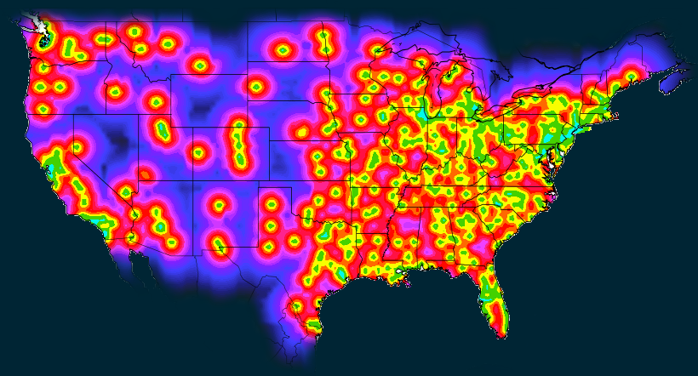
Health System Solution
Medicare Part B
Neurology, Nephrology, Cardiac Surgery
Miles to Care
0 70 150 250

Slide 10





Industry Benefits
Maximize ACO Specialty Provider Attribution
Reduce Hospital Readmission Rates
Reduce ED Utilization for Primary Care Providers
Replace Post-Acute Care w/ Preventative
Improve VBP Performance and Patient Satisfaction
Analyze Population Health, Improve Outcomes, Lower Costs

Slide 11


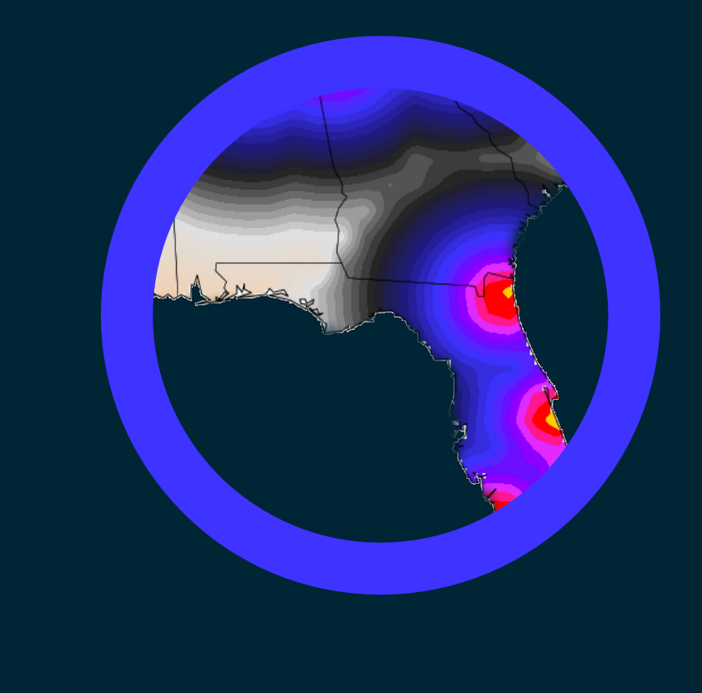
How It Works: API
1
2
3
Connect prefered BI tool to the mapping platform
Customize query parameters
Discover geographic gaps in care availability

Slide 12
Future Goals
Current Stack:
Python Analysis/Dataviz
SQLite Database
Ruby, Jekyll, JS Frontend
Leaflet Geo,D3, Google Maps API
Long Term Goals:
Full capacity analysis with populations
Unified platform
Security layer, and DB encryption
Better geolocation granularity
API to patient portals
Blue Button, Direct integration
Special Thanks:
Erick Larin, Robert Scott Herrick, Eric Robbins, Alisa Woideck, Sheri Barley, Neueon and James Scott, Adaptive Project Solutions (Craig Steffen and Doug Mitchell), HL7S and Chad Johnson, Mark Silverberg, Rodolfo Sanchez, Harold Smith, Steve Sisko, Lynn Phillips, John Lynn, Greg Meyer, David Meyers, Brent Meyers, Esther Phillips and many more! Thank you for the love and support!

Slide 13
Questions
Get it? Got it? Good!
@TeamFloriduh
teamfloriduh.com

